Slide 1
Taking DevOps to Next Level with VS 2019

Slide 2
Dinesh Kumar P Product Manager, Data platform Syncfusion Software Twitter - @dinuswt22 dinesarun@hotmail.com

Slide 3
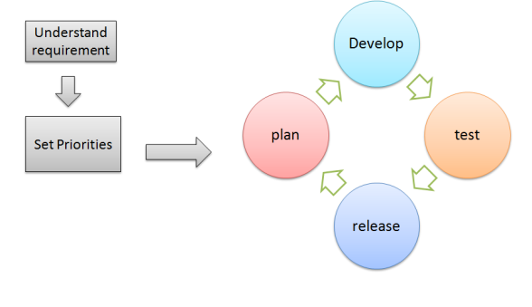
Developer’s Life Cycle

Slide 4

Everything now being made available as SaaS
E.g. MS Office now – MS Office online
Even Visual Studio would be GA as SaaS

Slide 5





Deliver
with Azure DevOps
Azure Boards
Azure Repos
Azure Pipelines
Azure Artifacts
Azure Test Plans

Slide 6
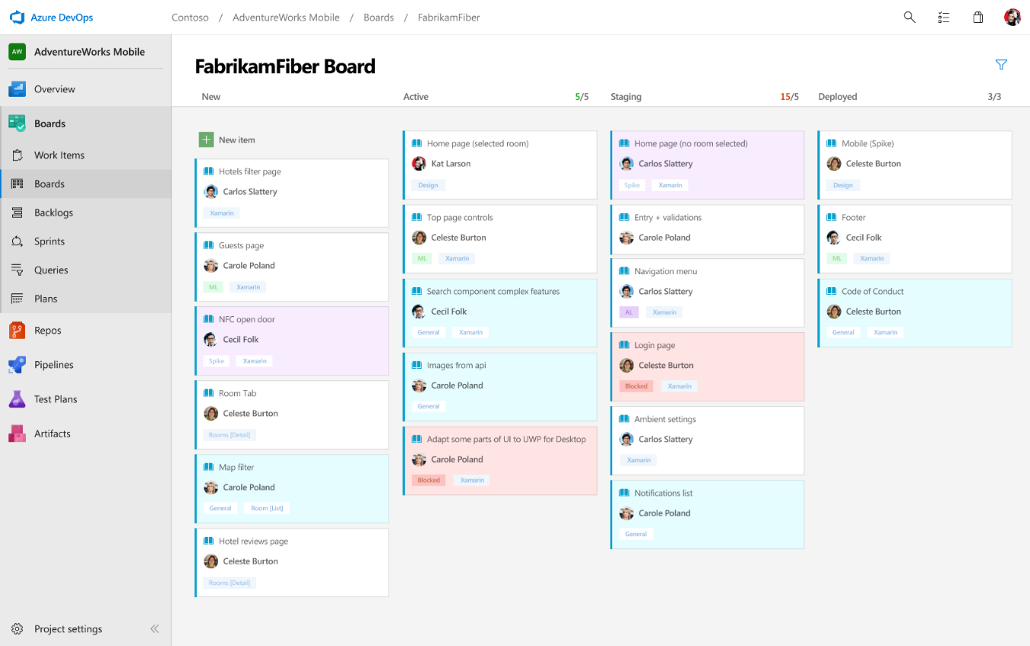
Deliver
Azure Boards
Azure Repos
Azure Pipelines
PLAN
Connecting ideas to releases
Scrum ready to help your teams run sprints
Integrated with GitHub commits and pull requests
Insights into project status and health
Azure Artifacts
Azure Test Plans

Slide 7
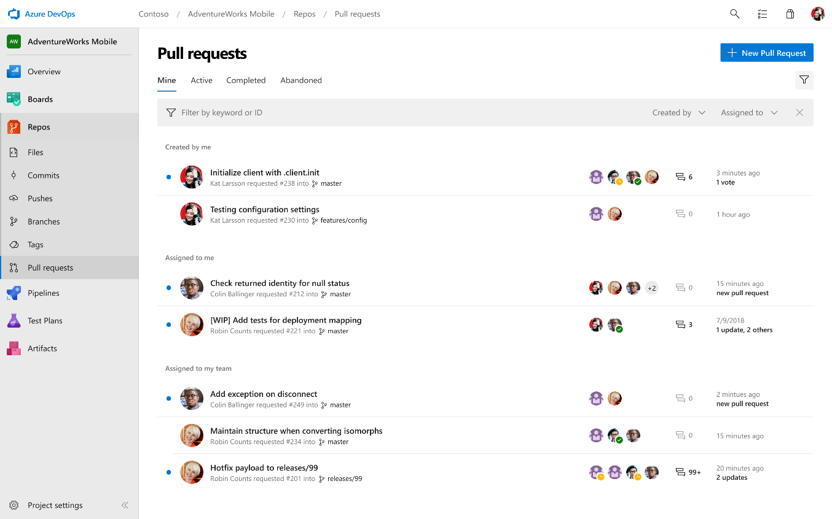
Deliver
Azure Boards
Azure Repos
Azure Pipelines
DEVELOP (Source code maintenance)
Private Git for your teams
Code review via branch pull requests
Branch policies and build validation
Easy migration path to / from GitHub
Azure Artifacts
Azure Test Plans

Slide 8
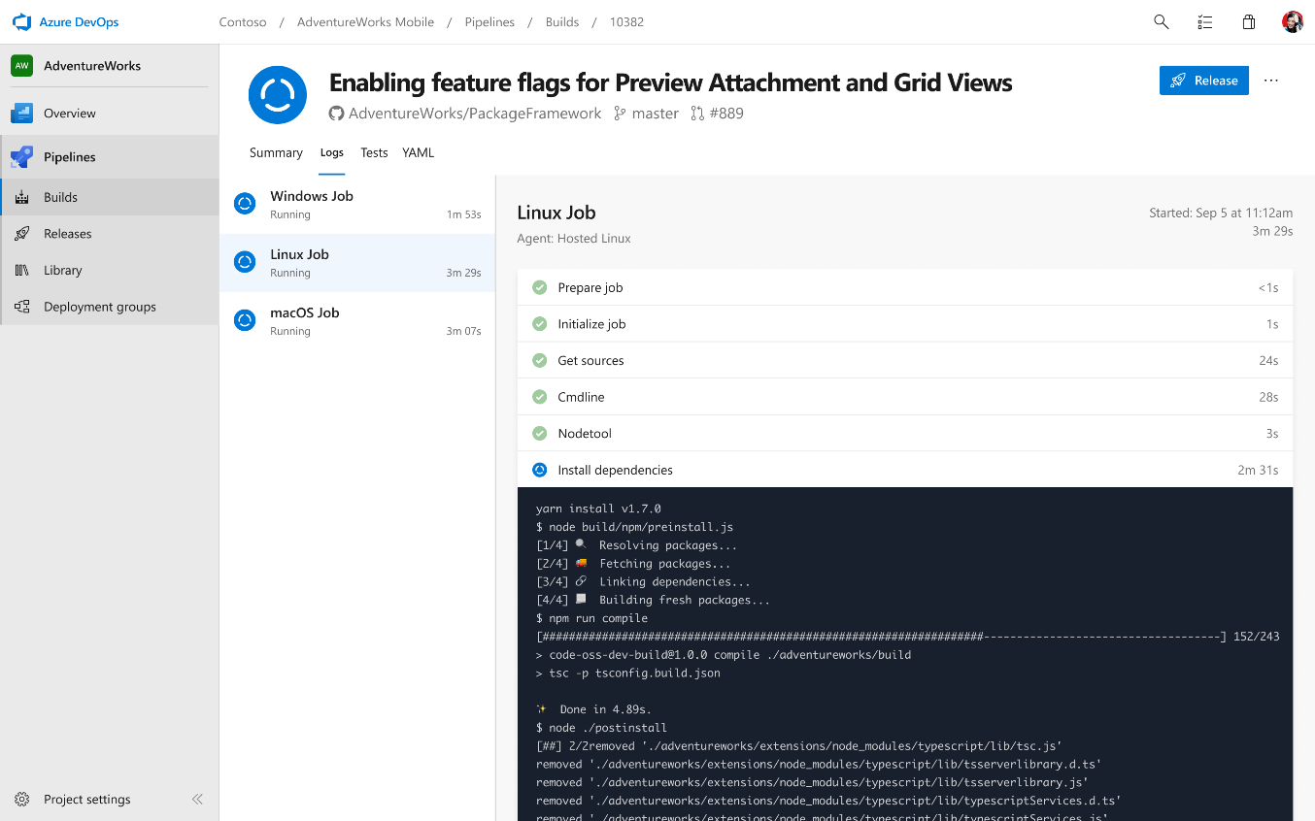
Deliver
Azure Boards
Azure Repos
Azure Pipelines
TEST – CI , CD
Any language, any platform, any cloud
Native support for containers and Kubernetes
Best-in-class for open source
Azure Artifacts
Azure Test Plans

Slide 9
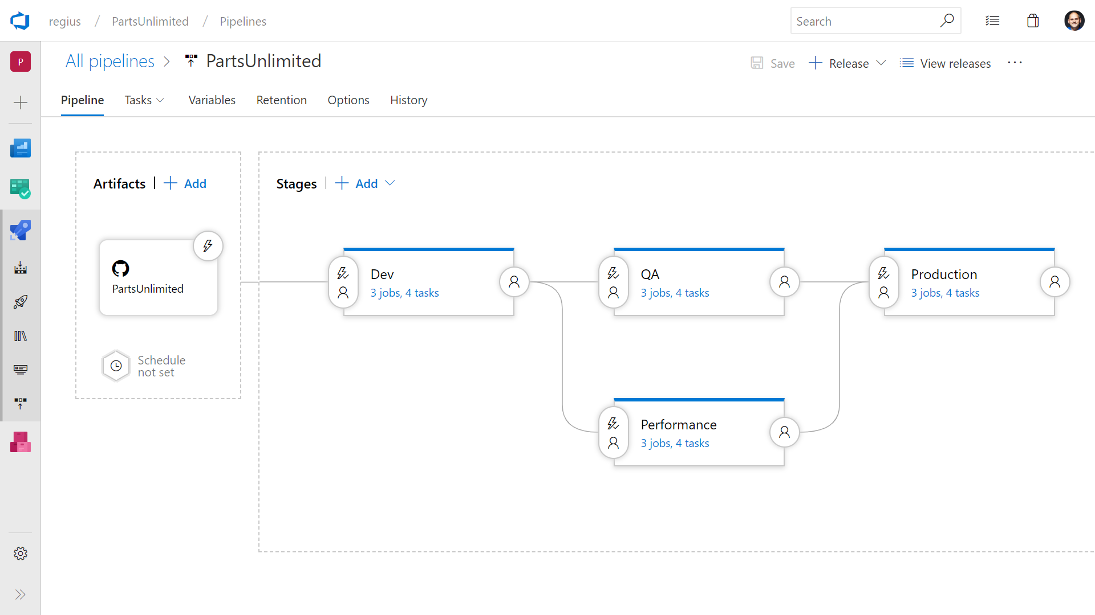
Deliver
Azure Boards
Azure Repos
Azure Pipelines
TEST – CI , CD
Deploy to on-premises, ANY cloud or a hybrid of cloud and on-prem
Staged environment releases
Pre and post deployment approvals with gates to automate approval based on conditions
Azure Artifacts
Azure Test Plans

Slide 10
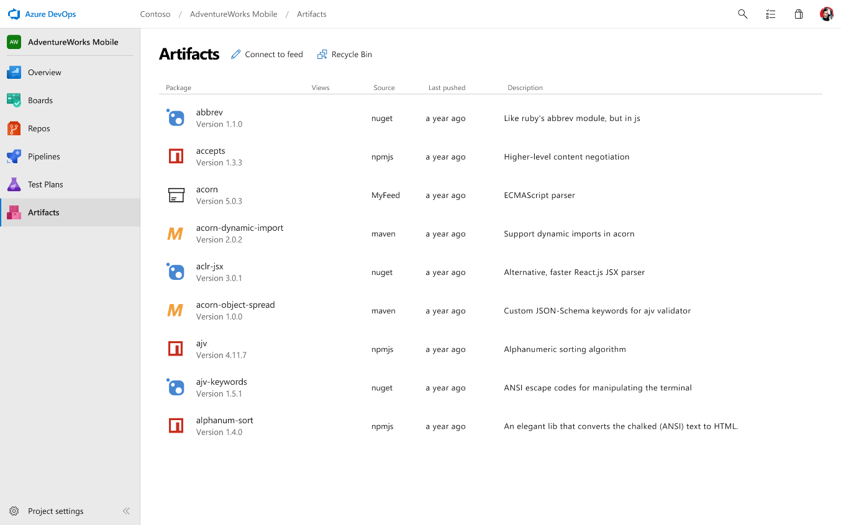
Deliver
Azure Boards
Azure Repos
Azure Pipelines
RELEASE
Manage all package types
Add packages to any pipeline
Share code efficiently
Azure Artifacts
Azure Test Plans

Slide 11
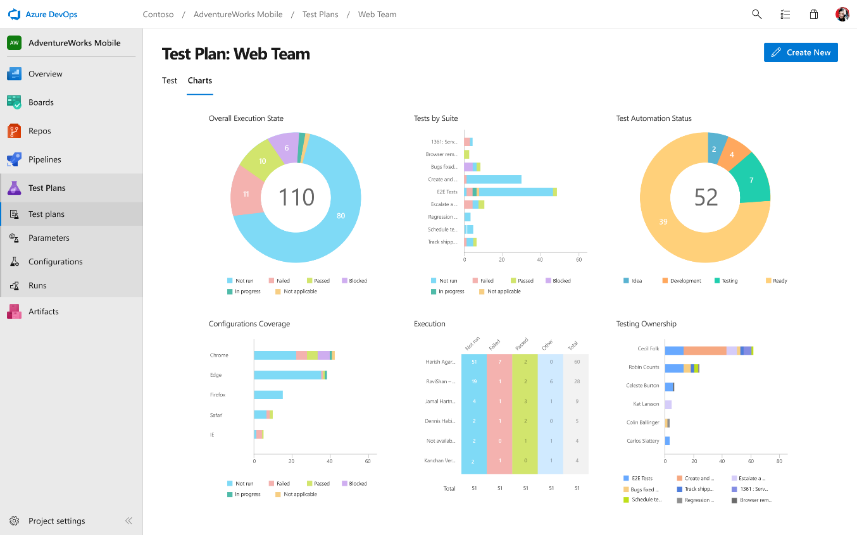
Deliver
Azure Boards
Azure Repos
Azure Pipelines
TEST
Run tests and log defects from your browser
Track and asses quality throughout your lifecycle
Capture rich data for reproducibility
Azure Artifacts
Azure Test Plans

Slide 12


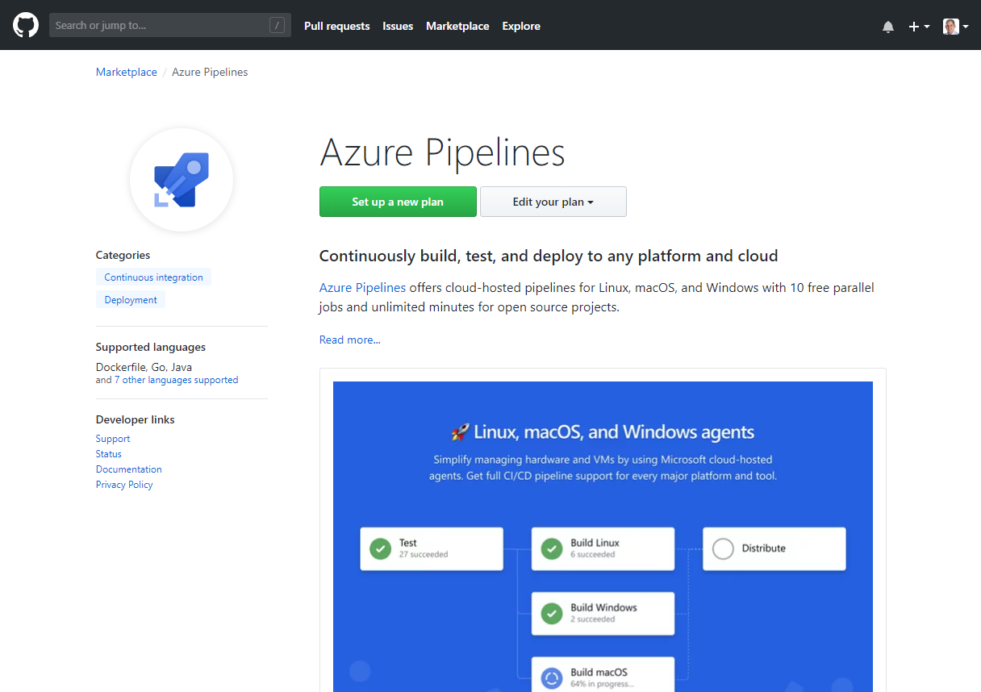
Azure DevOps Integrated with GitHub
Rich integration with Azure Pipelines and Azure Boards

Slide 13
Why does Azure DevOps brings in all services together?

Slide 14
Why does Azure DevOps brings in all services together?
Context switching
Switch less
Be more productive

Slide 15

How this integration would been done?
Visual Studio and Azure DevOps
Connection - OAuth
Communication - REST
Similar to the integration done in BI tools ‘Power BI’ / ‘Bold BI’

Slide 16
Follow along (later)
Demo generator: https://azuredevopsdemogenerator.azurewebsites.net/
Walkthrough: https://github.com/hsachinraj/GitHub-AzureDevOps
GitHub Extension for VS: https://visualstudio.github.com/

Slide 17
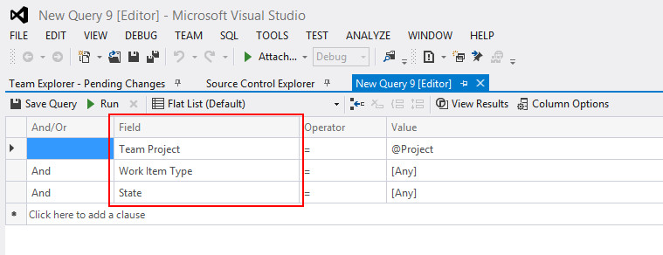
Azure Boards VS 2017 and earlier

Slide 18
Demo

Slide 19
Questions?

